Slide 1


StoryBoard

Slide 2
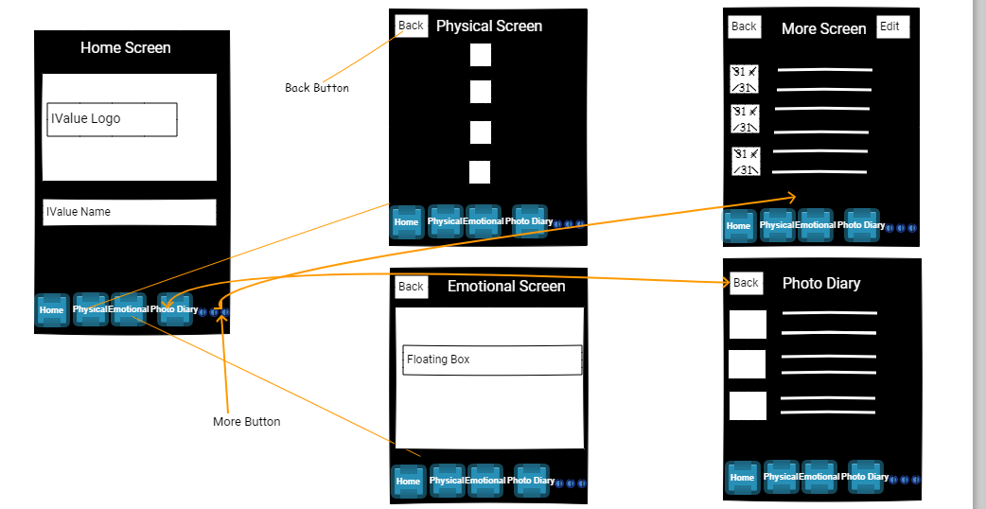
Home Screen

Slide 3
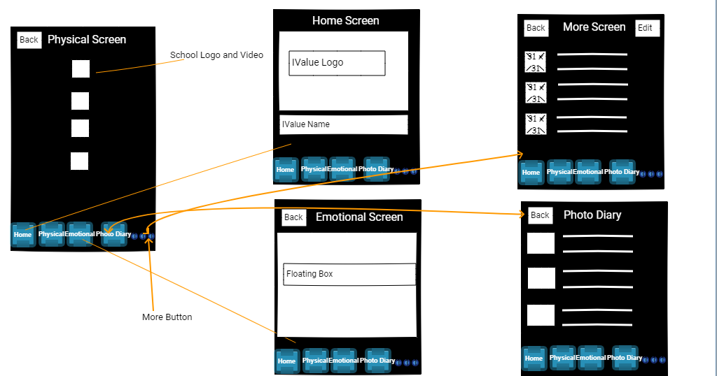
Physical Screen

Slide 4
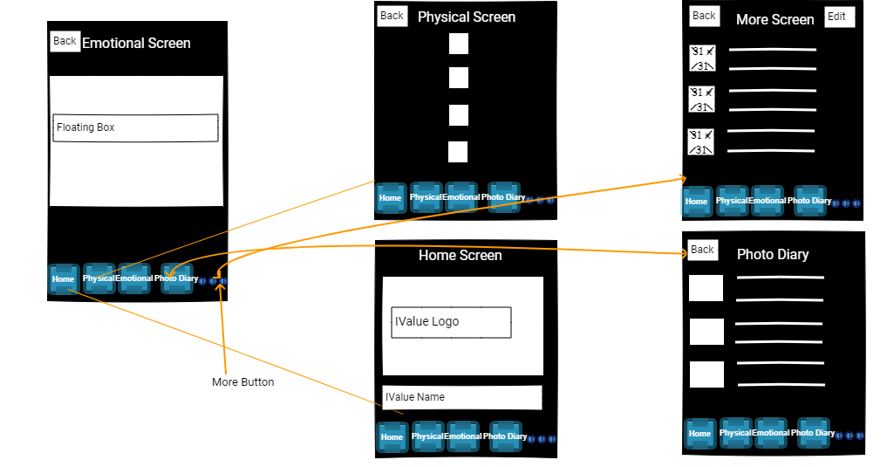
Emotional Screen

Slide 5
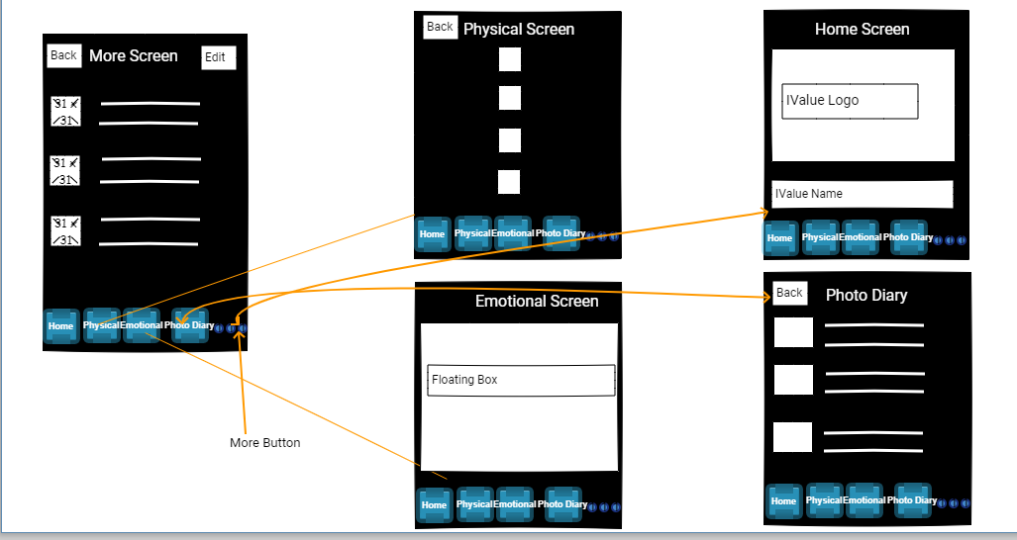
More Screen

Slide 6
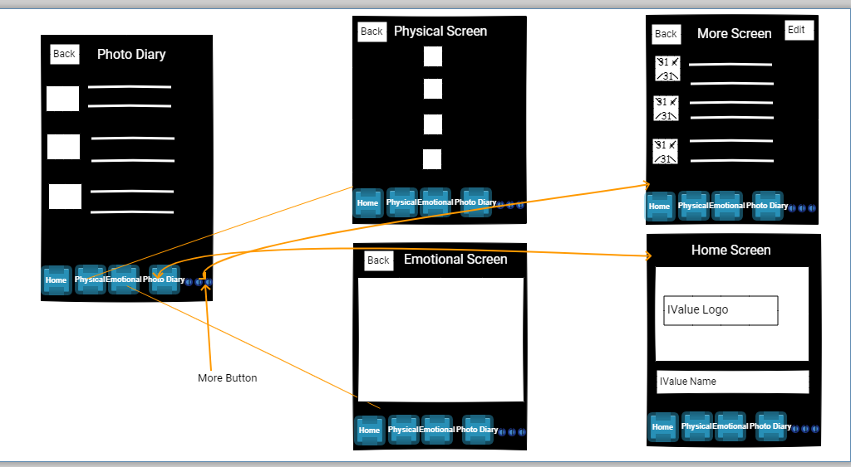
Photo Diary

